Slide 1
Goat talk
Who is the best nba player of all time????

Slide 2


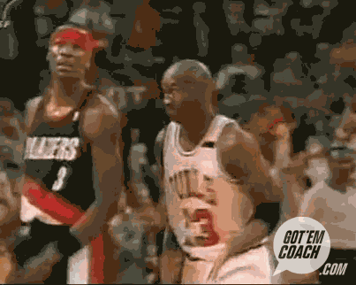

Slide 3
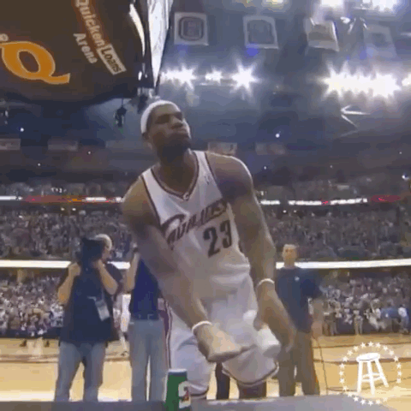

Slide 4
The problem…..
It can go back as far as the early days of the Nba, and the aba…..who is the greatest Nba player of all time?
Magic Johnson and larry bird elevated the nba out of the tape delayed 1980’s.
Kareem abdul-jabbar was the most prolific scorer in history
Everyone wanted to be like mike (Jordan) in the 90’s
Lebron james is the king

Slide 5
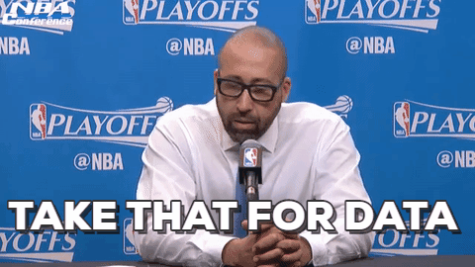
Where do we start???

Slide 6
players
Kareem abdul-jabbar
Magic johnson
Larry bird
Isiah thomag
Michael Jordan
Hakeem ojaluwon
Shaquille o’neal
Allen Iverson
Kobe Bryant
Tim Duncan
Dirk Nowitzki
Lebron james
Dwyane wade
Kevin Durant
Stephen curry

Slide 7
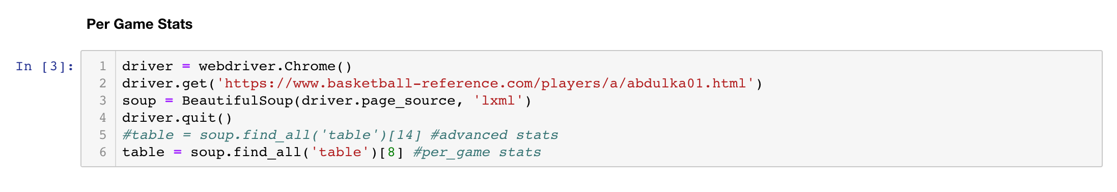
Web scraping

Slide 8
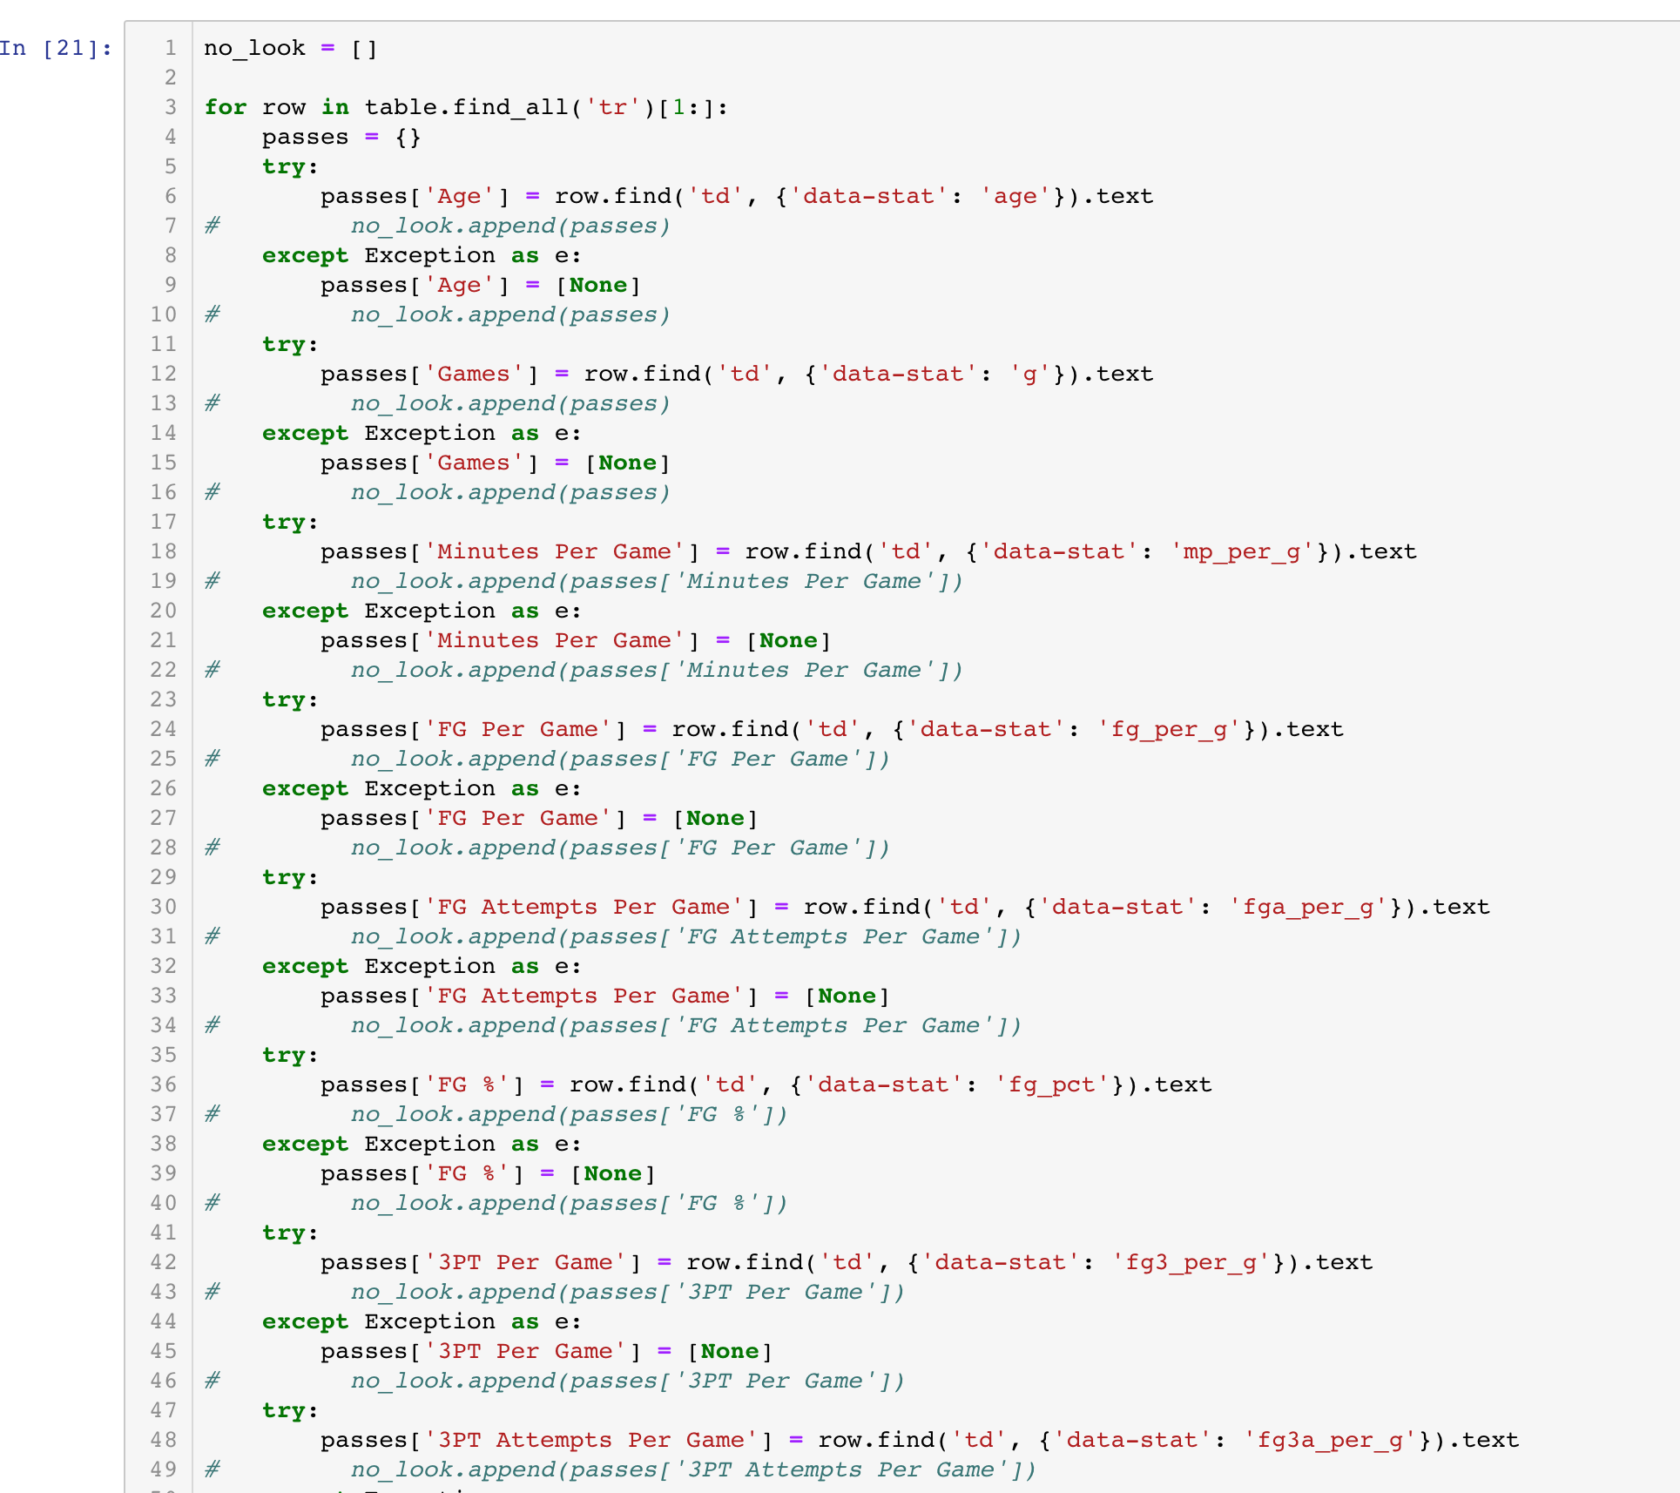
More web scraping – this time with blank values

Slide 9
What features were we looking for???

Slide 10
Features
Per game
Age, Games Played, Minutes, Field Goal % (Made and Attempted #), 3-Point FG % (Made and Attempted #), 2-Point FG % (Made and Attempted #), Effective FG %, Free Throw % (Made and Attempted #), Offensive Rebounds, Defensive Rebounds, Total Rebounds, Assists, Steals, Blocks, Turnovers, Player Fouls, and Points
Advanced
Player Efficiency Rating (PER), True Shooting %, Total Rebounding %, Assist %, Steal %, Block %, Turnover %, Usage %, Win Shares, Offensive Box +/-, Defensive Box +/-, Overall Box +/-, and Value Over Replacement Player (VORP)

Slide 11
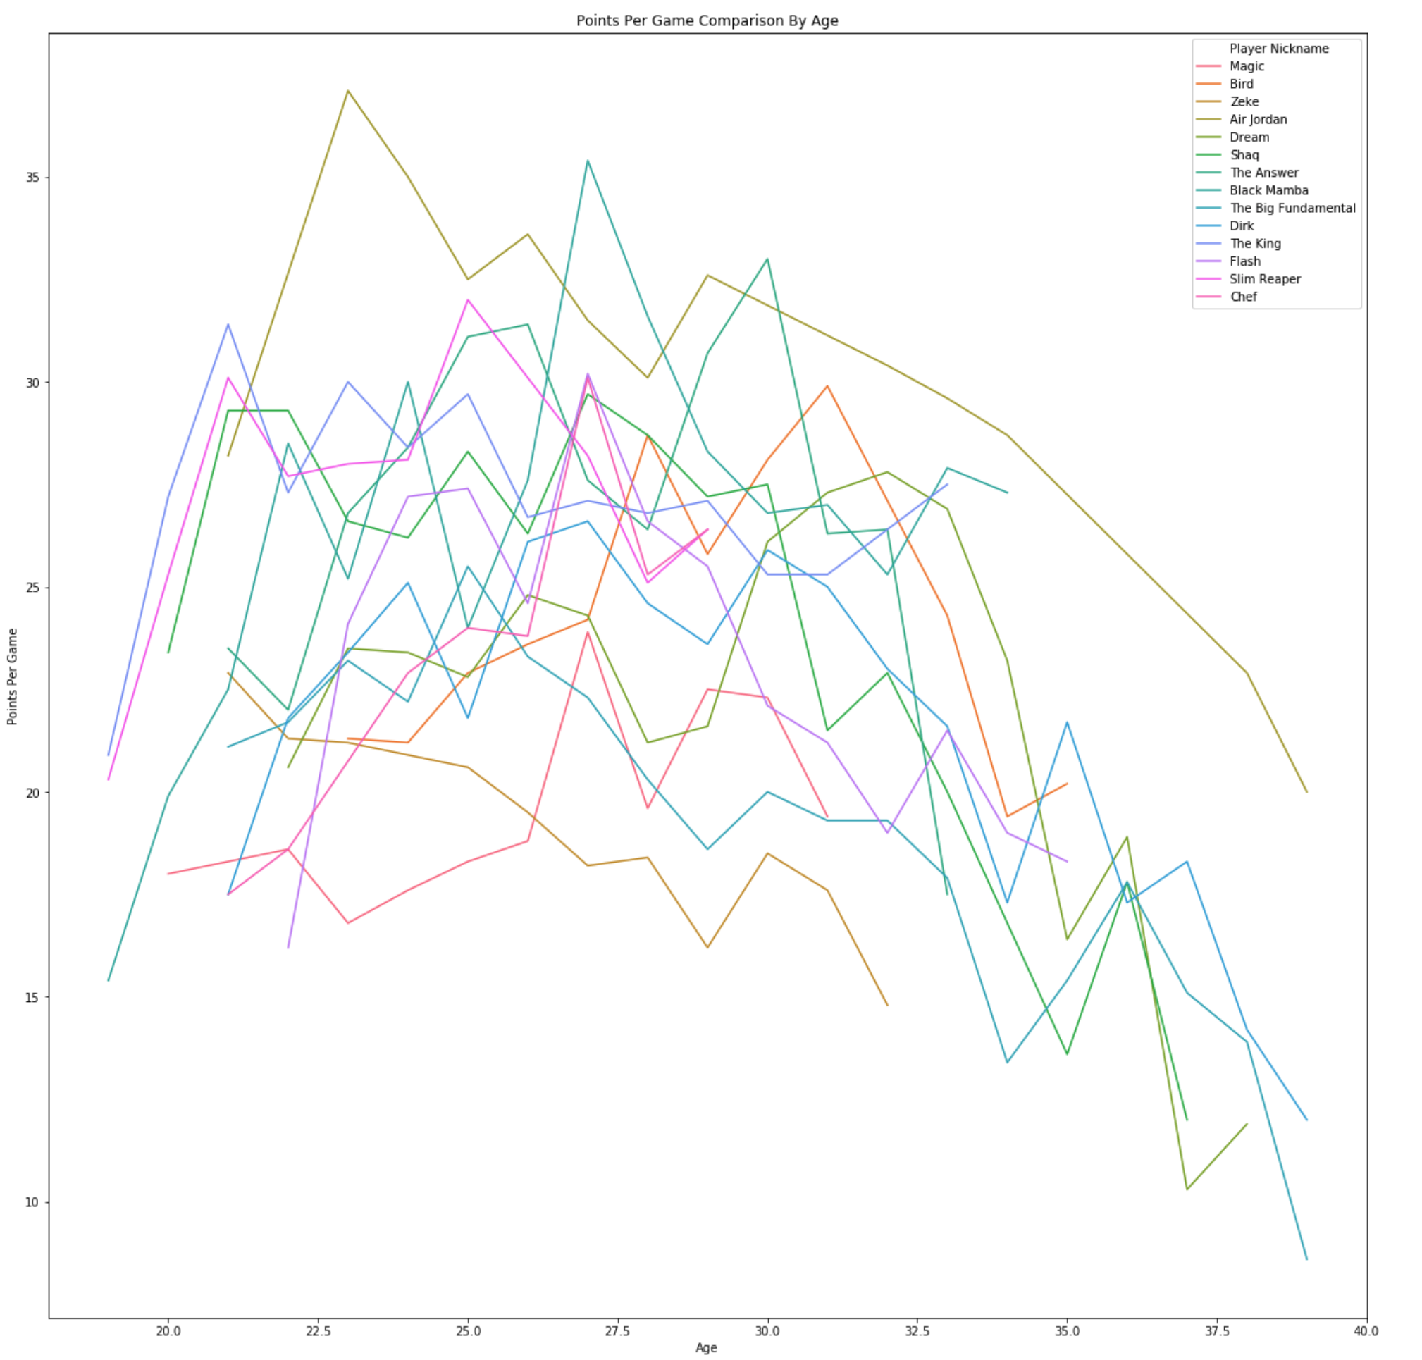
Points per game

Slide 12
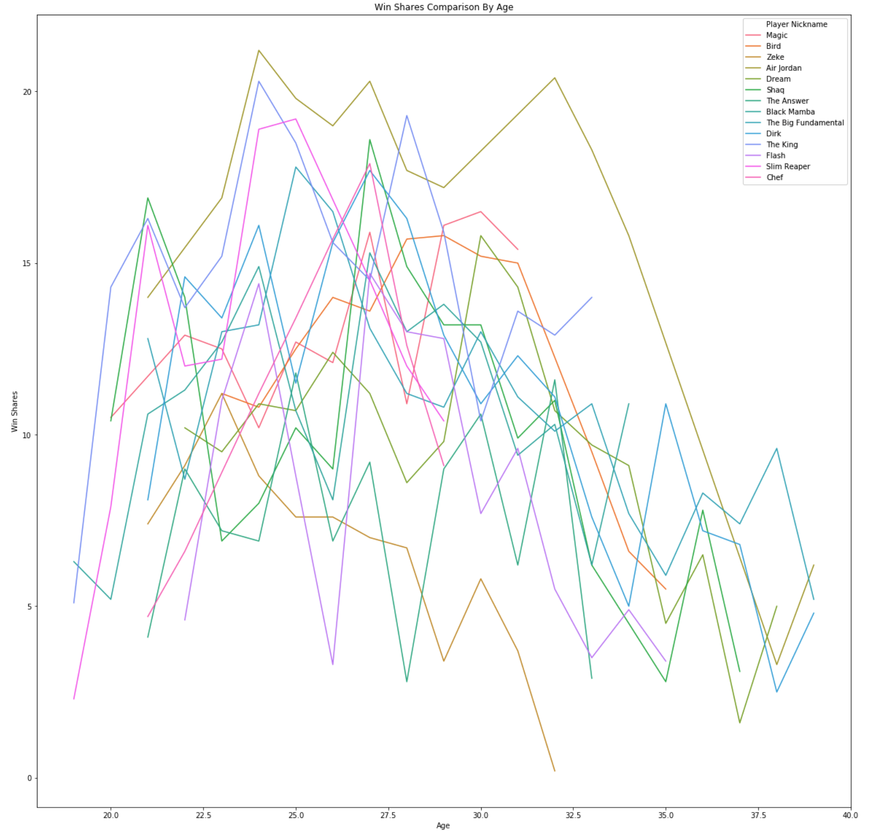
Win shares

Slide 13
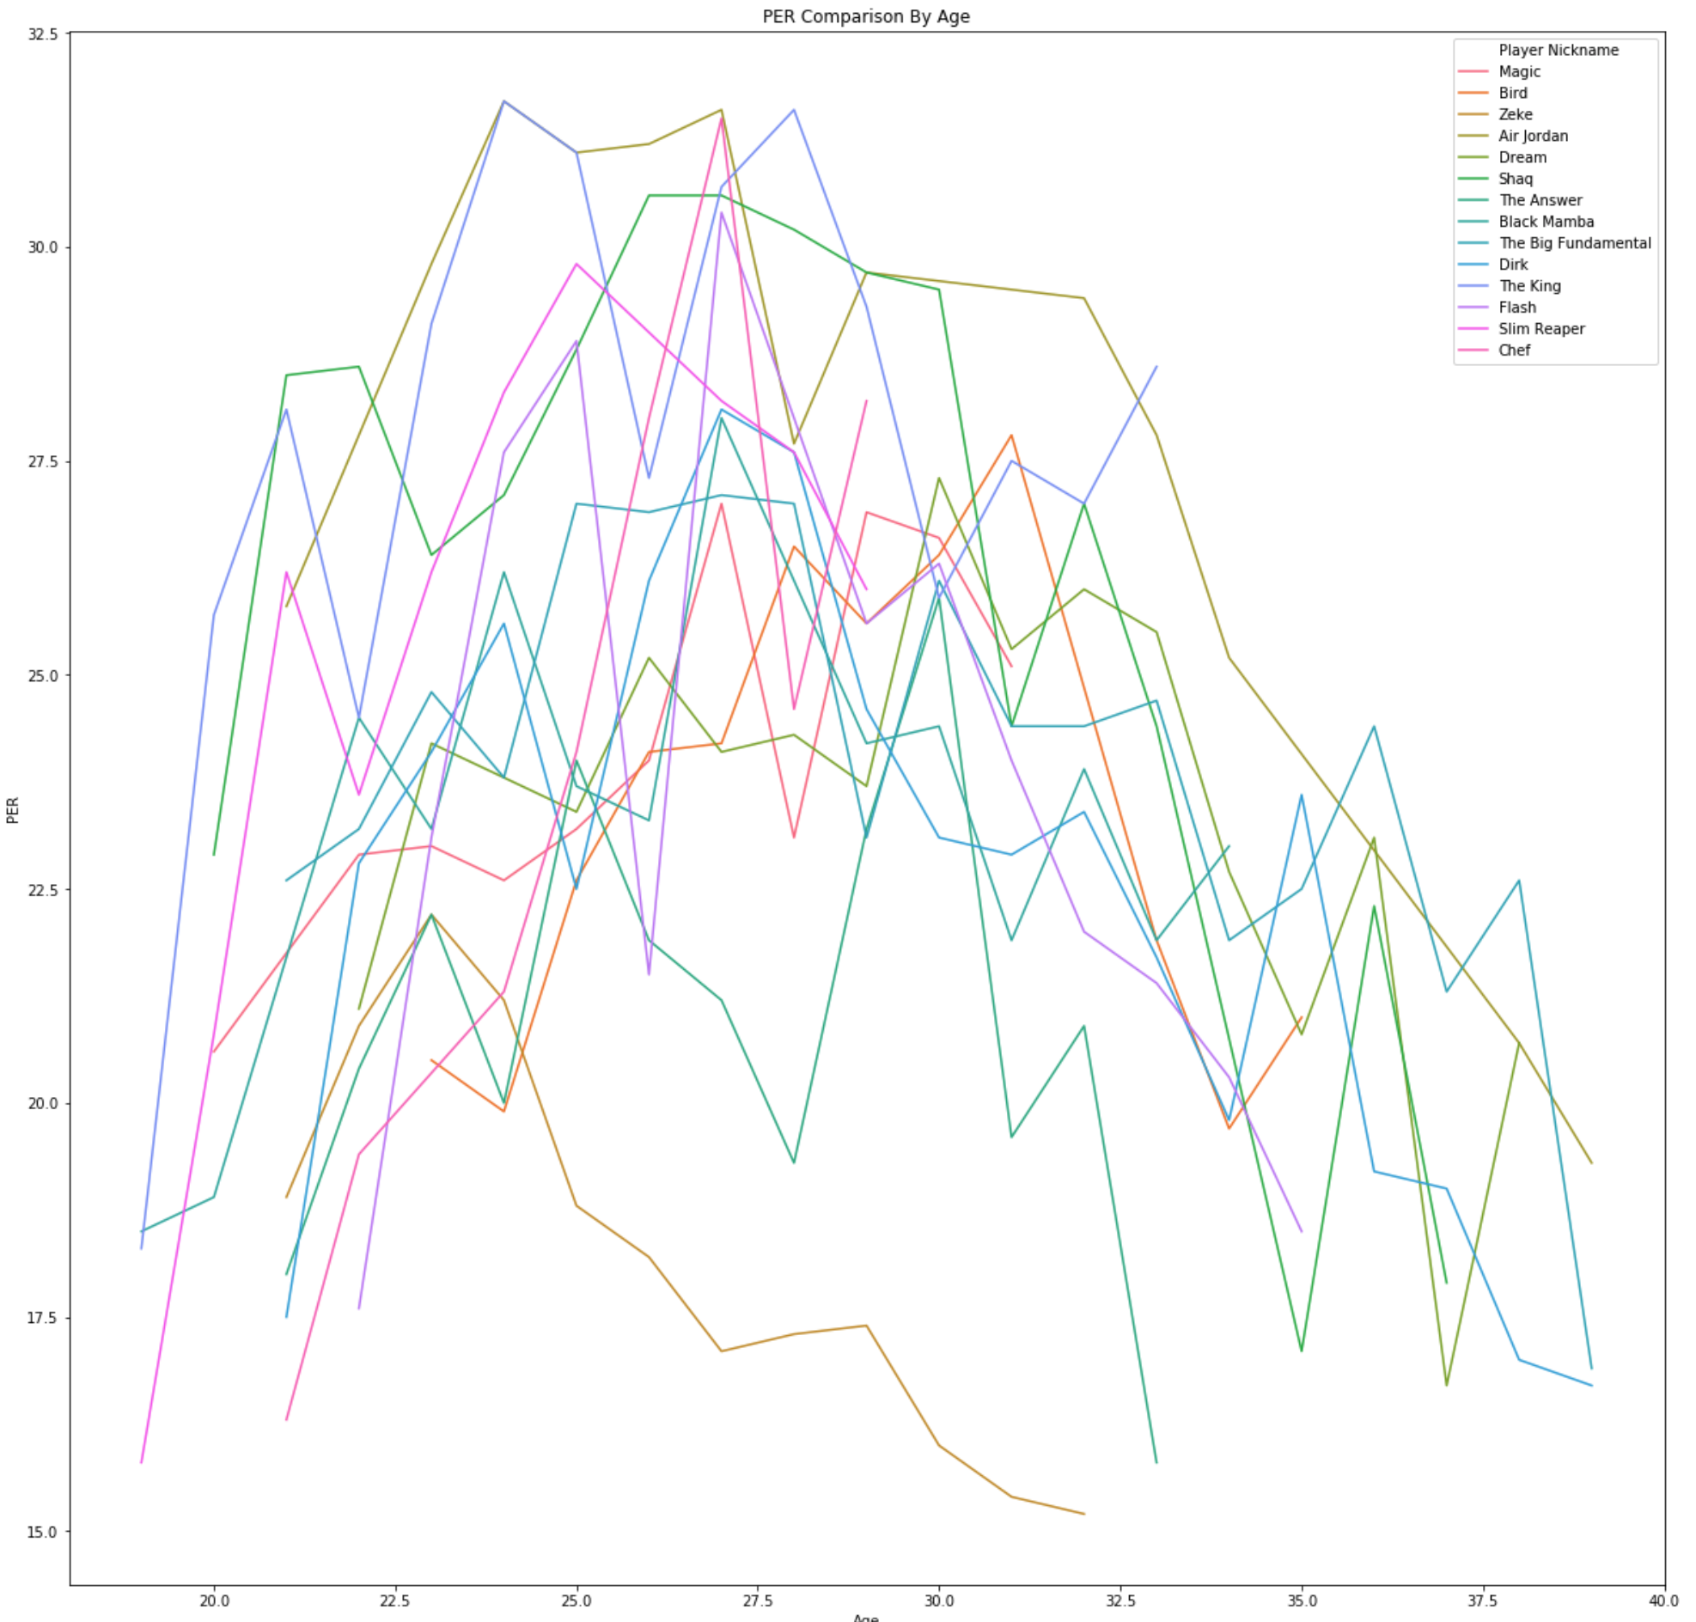
per

Slide 14
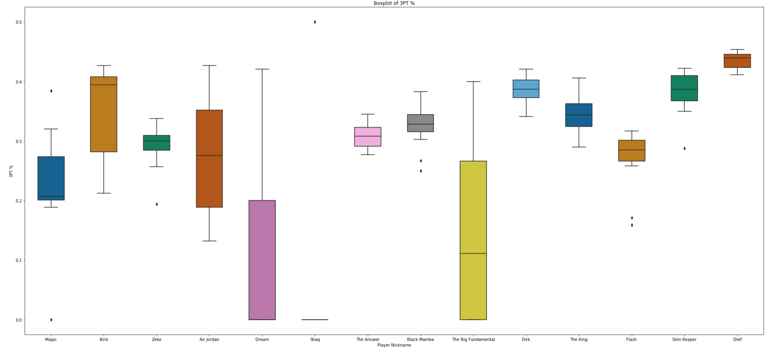
3-point %

Slide 15
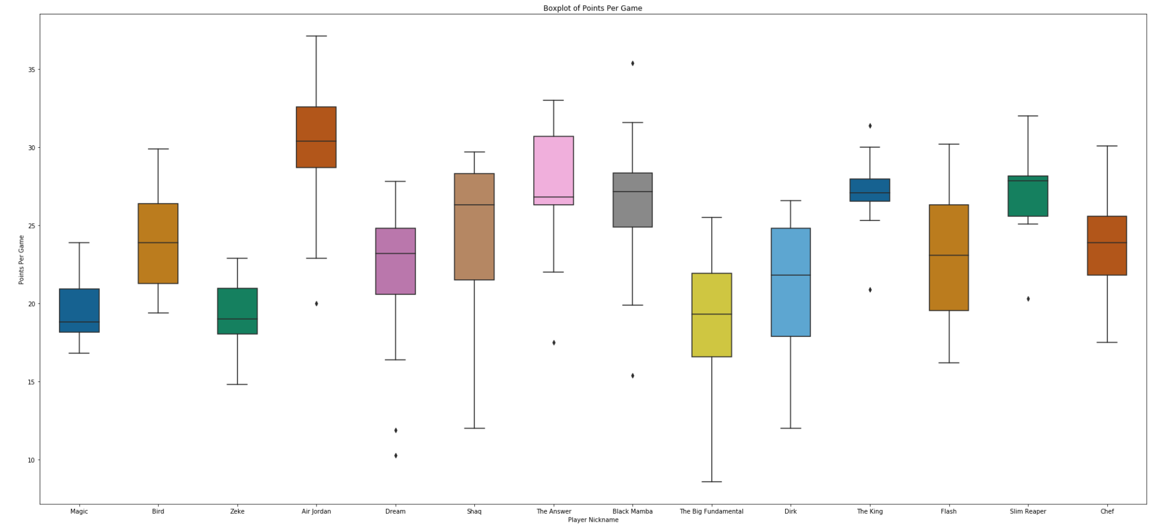
Points per game boxplot

Slide 16
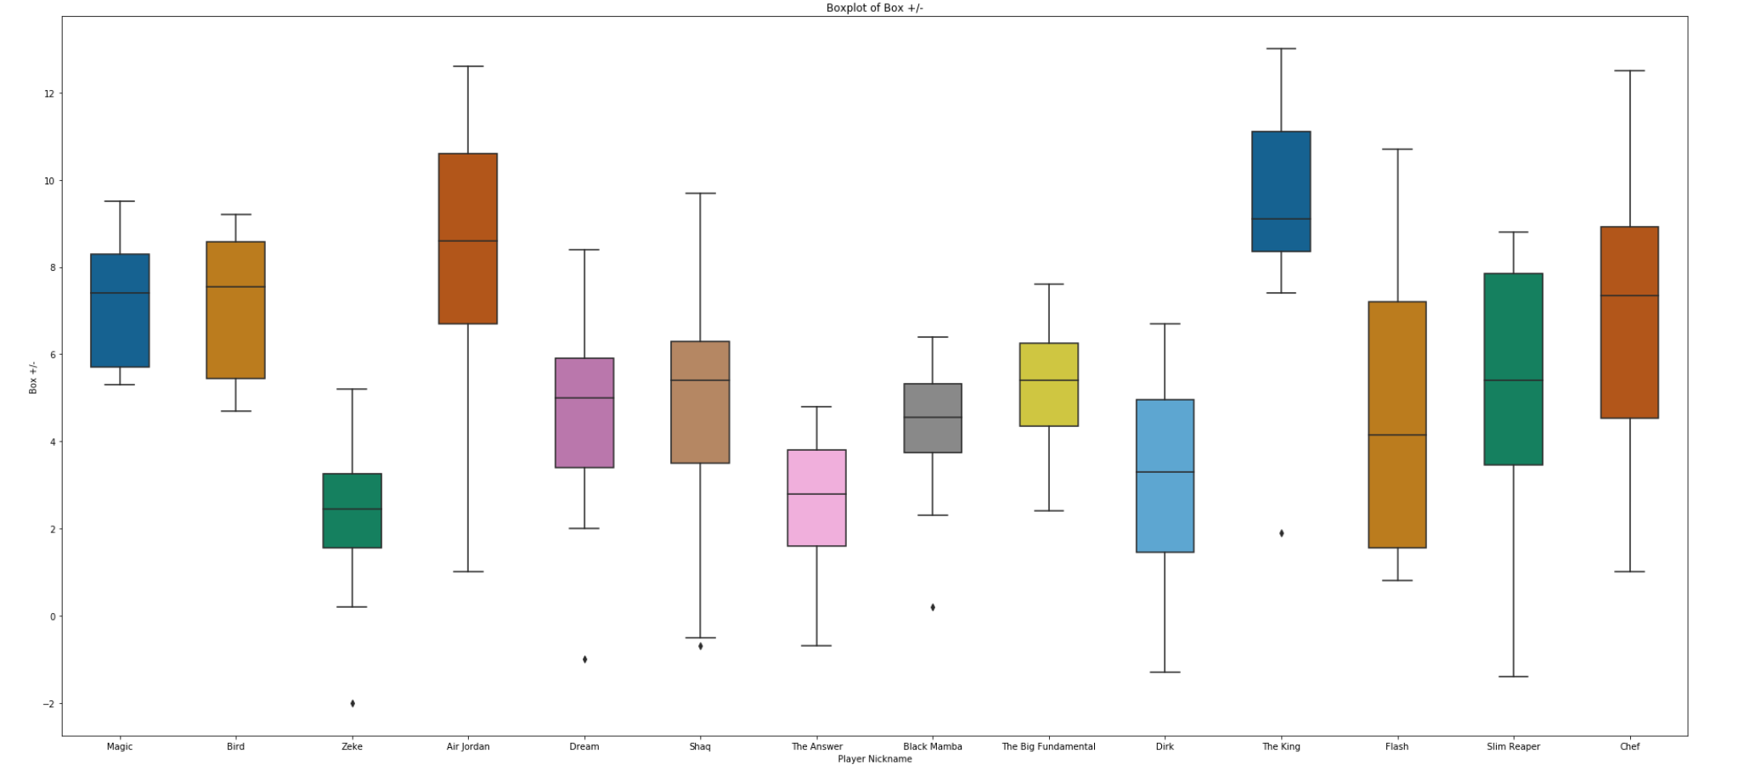
Box +/-

Slide 17
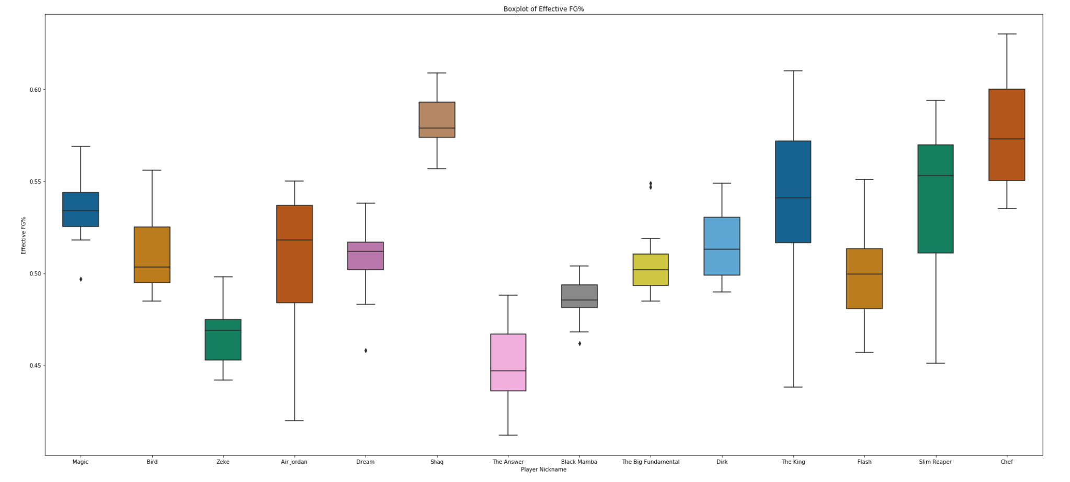
Effective fg%

Slide 18
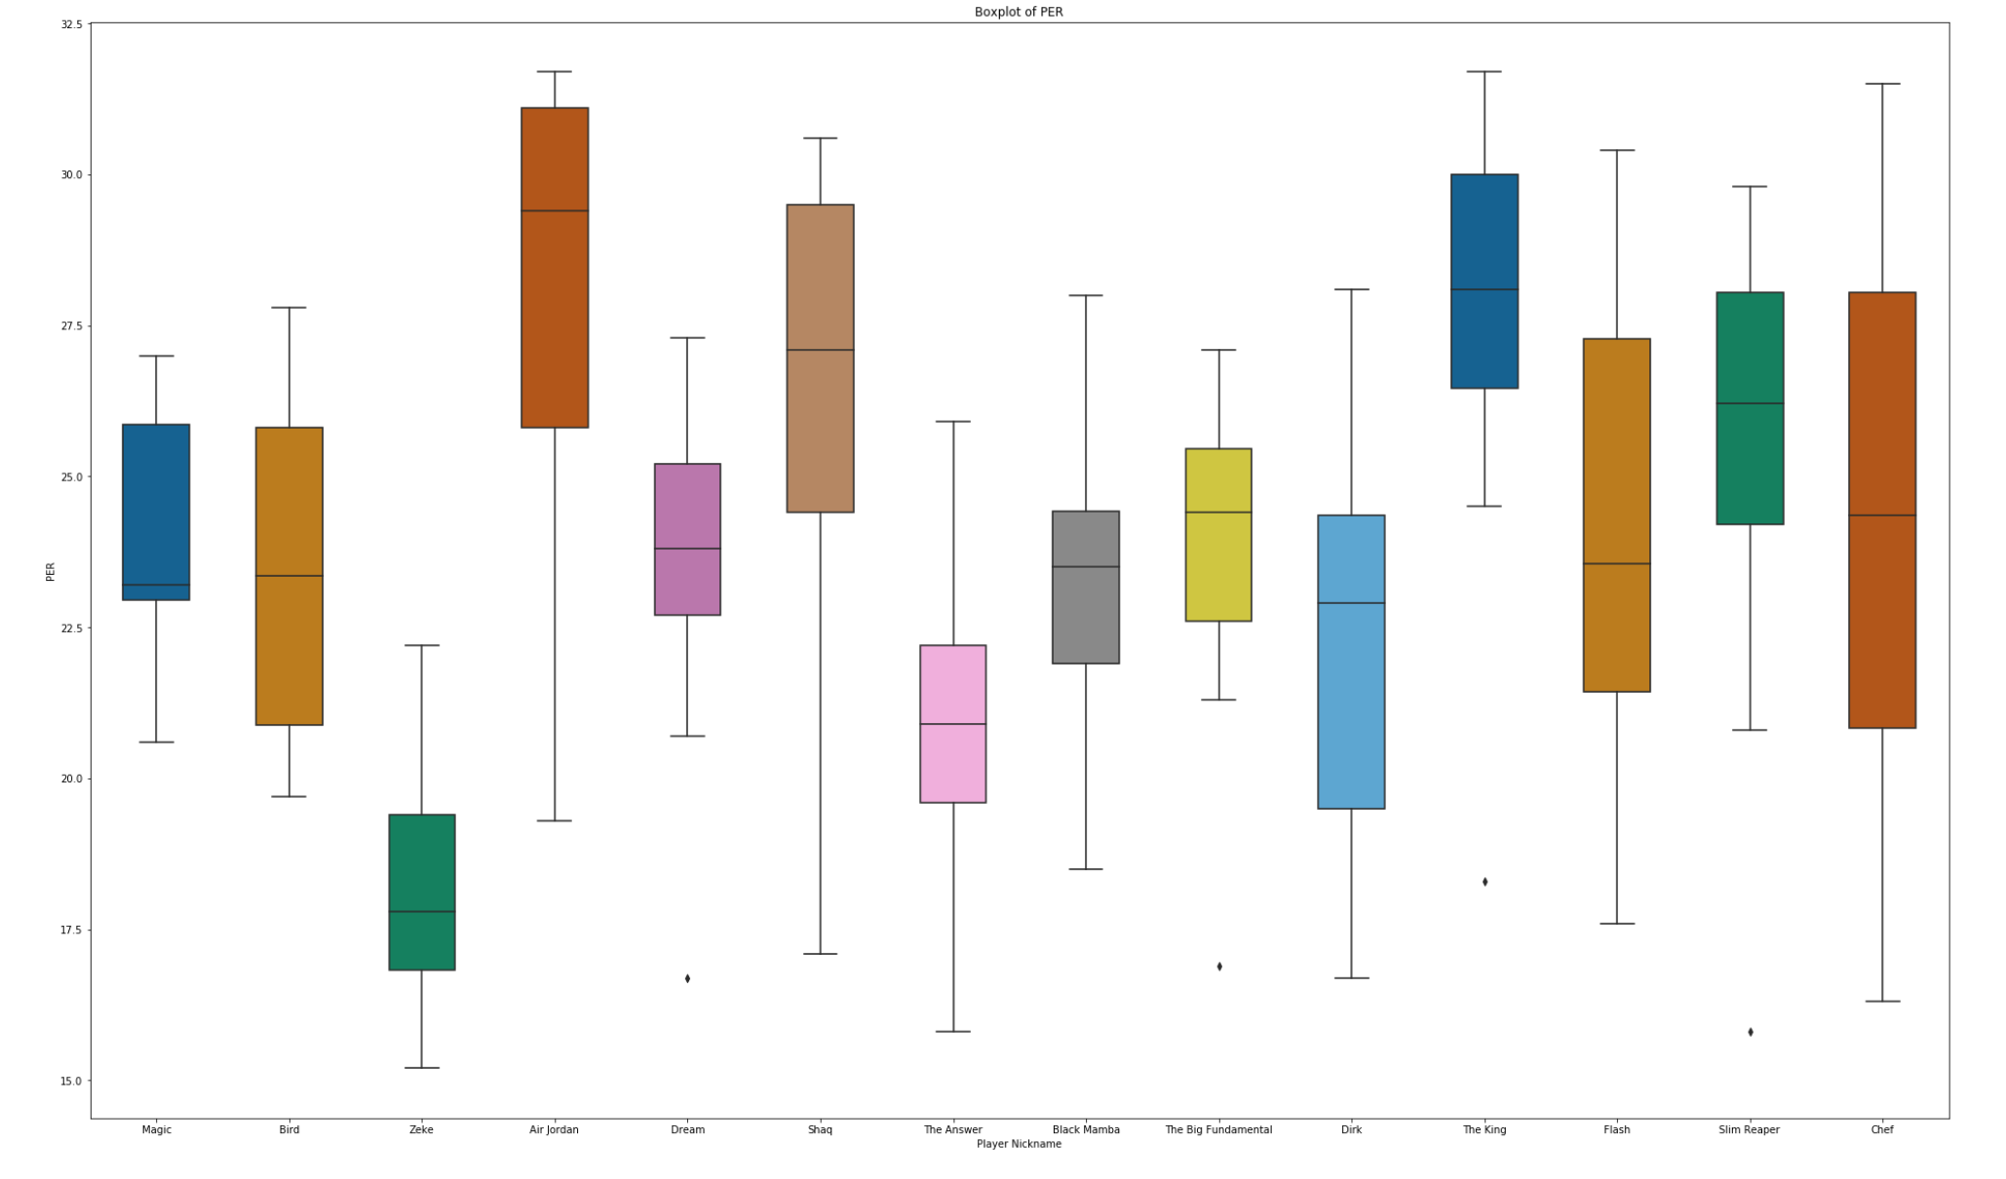
Per boxplot

Slide 19
Jordan wins

Slide 20
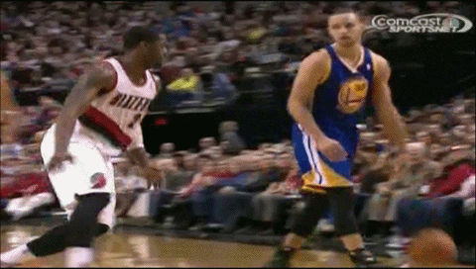
Steph and lebron not far…

